Slide 1
Welcome To York Code Dojo
David Betteridge @da_betteridge
Yorkdevelopers.org
@yorkdevelopers
@yorkcodedojo

Slide 2
Agenda
Quick Introduction
Explain the problem
Work in pairs till 8.45pm
Opportunity to show off solutions
Pub about 9pm

Slide 3
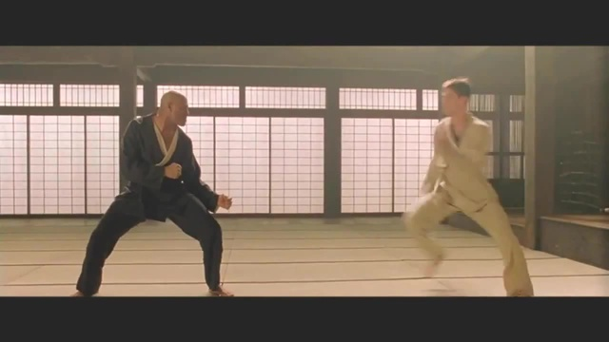
Code Dojo
Notes:
Who has been to a code dojo before?
What is the point?
It’s a place to practice coding safely. By that we mean it doesn’t matter if you haven’t solved the problem by the end of the evening. No one will judge you on it. It’s a place to practice, learn and try out new things.
For example you could use a language you have never used before, partner with someone new, try a different approach to solving the problem. You could add your own constraints; like my functions won’t have more than three lines; or I’m not going to use any IF statements.
(It’s also meant to be fun) It’s driving a car to work every day, you might cover a lot of miles, but if you are doing the same journey then does your driving ability really improve?
It’s driving a car to work every day, you might cover a lot of miles, but if you are doing the same journey then does your driving ability really improve?

Slide 4
Tonight – Code Obfuscation
Obfuscation is the obscuring of the intended meaning of communication by making the message difficult to understand, usually with confusing and ambiguous language

Slide 5
The Story
You work as a developer for the BlowThingsUp Software company producing large applications for military use. To win the latest multi-billion-pound contract your sales team made certain claims about the security of your software.
One of these claims was that if someone got hold of a copy of your source code then they wouldn’t be able to understand what it does.
At your latest team meeting, your boss, volunteered you for the job of researching if this is possible and how you would achieve it. She would like you to produce a proof-of-concept by the end of this evening.
Notes:
You work as a developer for the BlowThingsUp Software company producing large applications for military use. To win the latest multi-billion-pound contract your sales team made certain claims about the security of your software.
One of these claims was that if someone got hold of a copy of your source code then they wouldn’t be able to understand what it does.
At your latest team meeting, your boss, volunteered you for the job of researching if this is possible and how you would achieve it. She would like you to produce a proof-of-concept by the end of this evening.

Slide 6
Tonight
Work in pairs
Secretly pick one of the exercises from the list
Code it up so that it works
Create some unit tests
Obfuscate your code to make it hard to read/follow
After each change ensure your tests are still green
At the end of the evening we will try to work out what each teams code does

Slide 7
Exercises
Generate a list of square or triangular numbers
Generate a list of prime numbers
Generate a list of leap years
Generate a list of factorial numbers (1 x 2 x 3 …. x n)
Generate a list of Fibonacci numbers Fib(n) = fib(n-1) + fib(n-2)
Calculate PI using random numbers (Monte Carlo Method)
Find all the prime factors of a number
Encrypt a string (substitution cypher)
Notes:
Open-ended – write to screen, return a result, take an input etc

Slide 8
York Developers
Games Developers (Last Thursday of the month)
Code and Coffee (Monday and Wednesday mornings)
Agile York (3rd Wednesday of the month)
Dot Net York

